Slide 1

SMIT Chatbot
This presentation outlines the design and development of a conversational chatbot powered by Dialogflow to provide users with convenient access to information and services offered by Saylani Welfare.
Presented By: Ahmed Raza

Slide 2
Project Objectives
Saylani Roti Bank
Saylani Mass IT Training
The chatbot will provide information about the Roti Bank's operations and donation procedures, enabling users to easily access vital information and make contributions.
The chatbot will streamline the student registration process for the Mass IT Training program, providing users with a user-friendly interface to access course details, register, and submit their information.

Slide 3

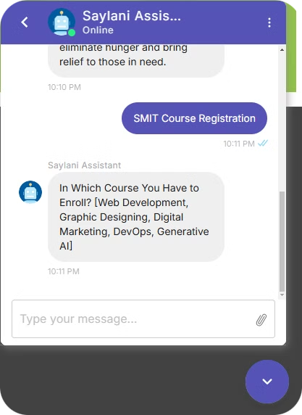
Chatbot Key Features
Roti Bank Module
Mass IT Training Module
Provides information about the Roti Bank's purpose, operations, and how users can avail services.
Offers information about the IT training program and available courses.
Provides guidance on registration requirements.
Facilitates inquiries about donation processes.
Accepts and stores student registration details, such as name, contact information, and course preference.
Answers frequently asked questions about operating locations, meal schedules, etc.

Slide 4
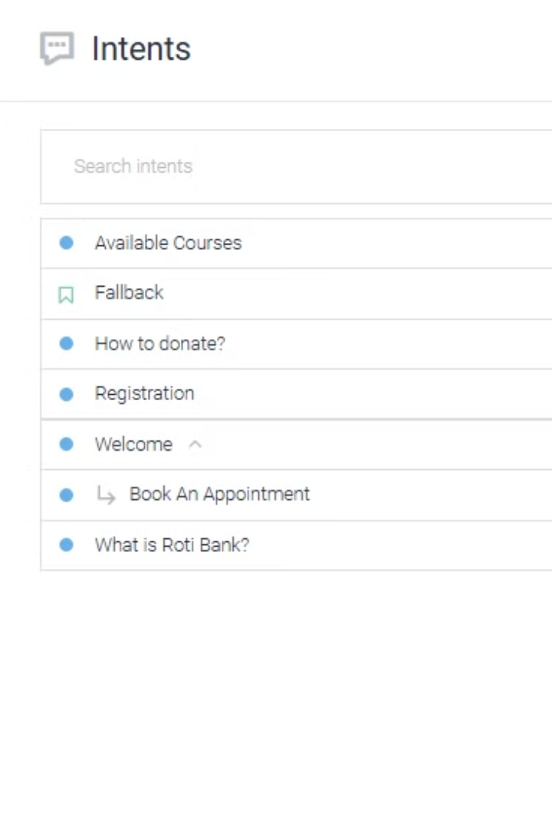



Conversation Flow Design
Intents
Responses
Define specific user requests, such as "What is Roti Bank?" or "How to register for Mass IT Training?"
Create informative and tailored responses based on the user's intent, drawing information from the Saylani website.
Entities
Define specific pieces of information that can be extracted from user input, such as donation type, location, or course preference.

Slide 5

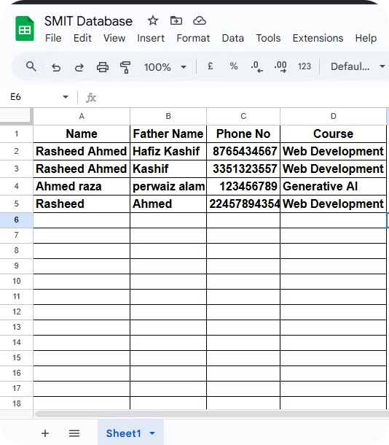
Data Collection and Storage
Student Registration
Collect student registration data, including name, contact information, and course preference, through the chatbot interface.
Data Storage
Store collected registration data securely in a database using webhook fulfillment. Firebase or Google Sheets can be utilized if a backend is not available.
Notification
Send automated email and phone notifications to registered students, confirming their registration and providing relevant information.

Slide 6
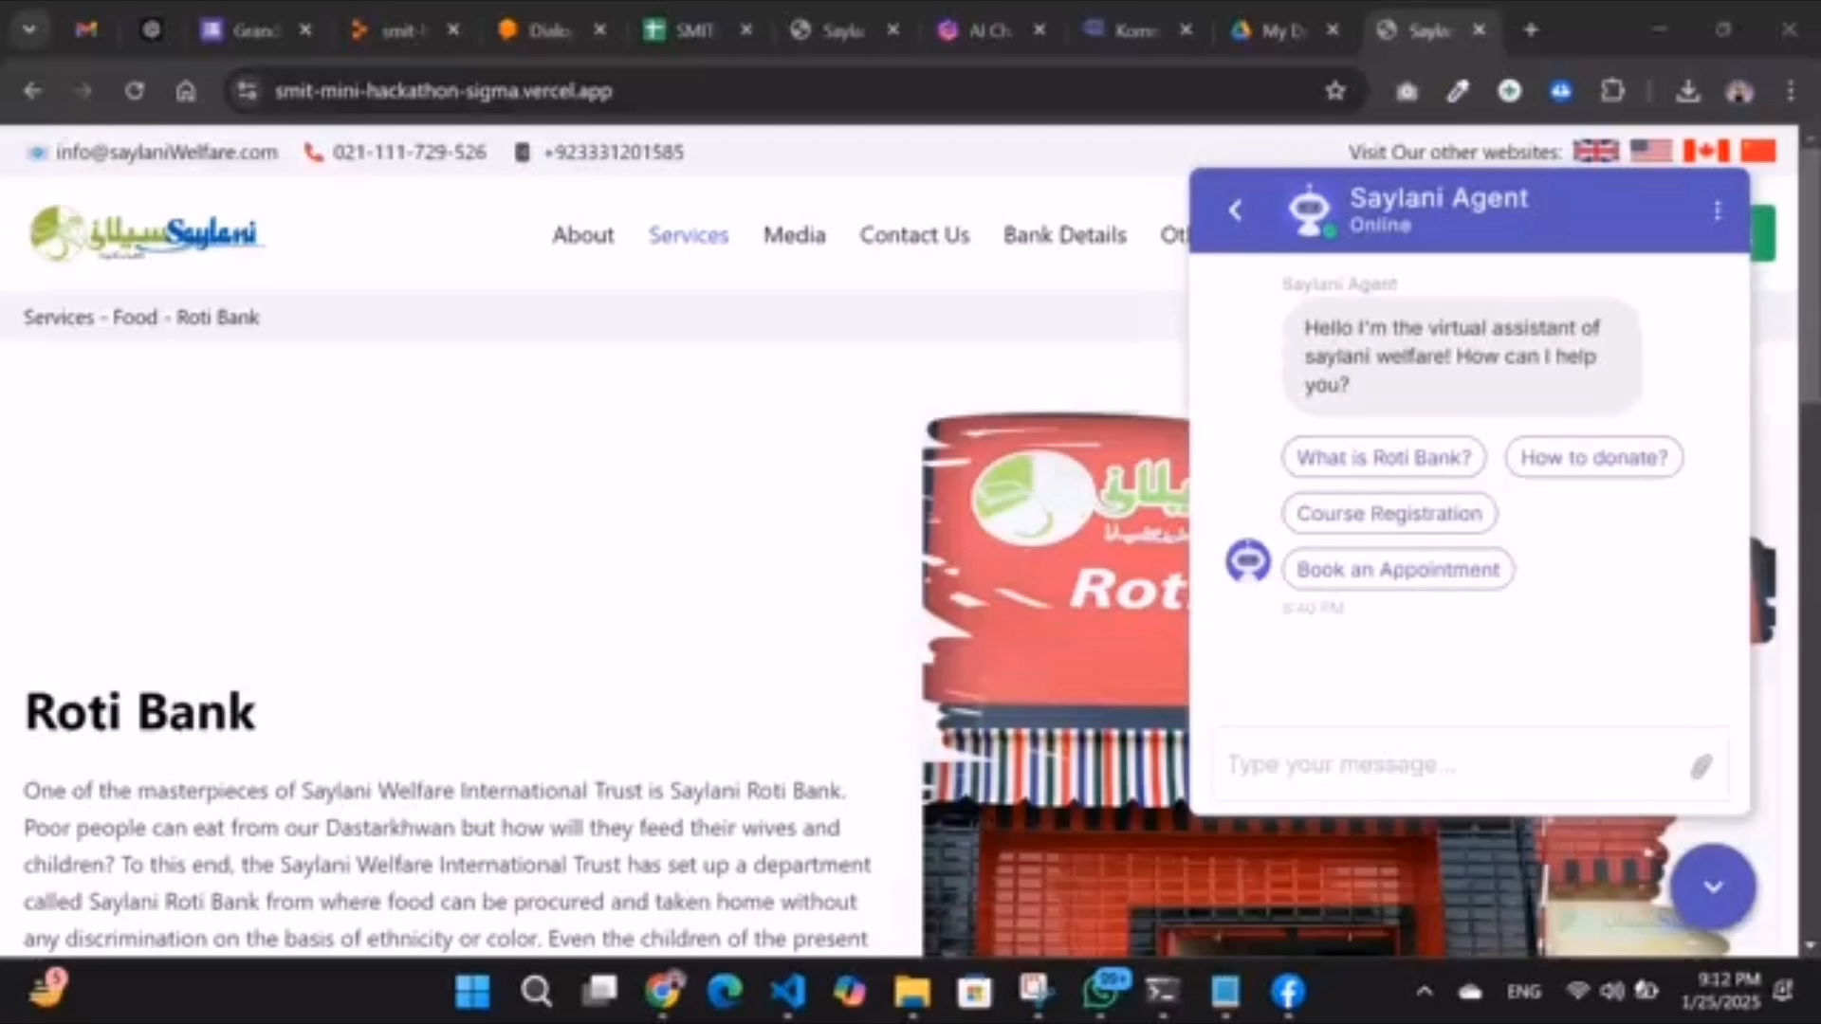
Website Integration

Slide 7
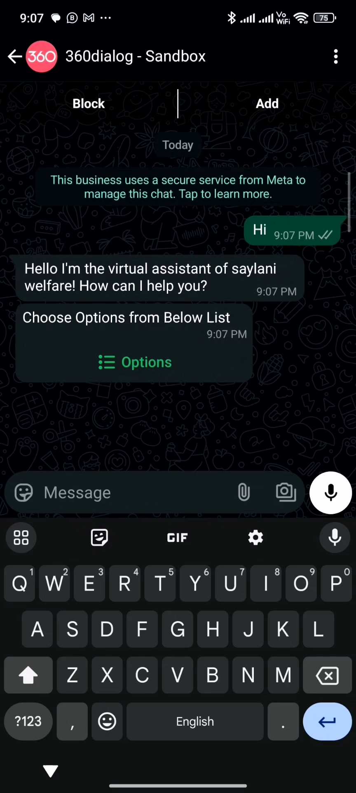
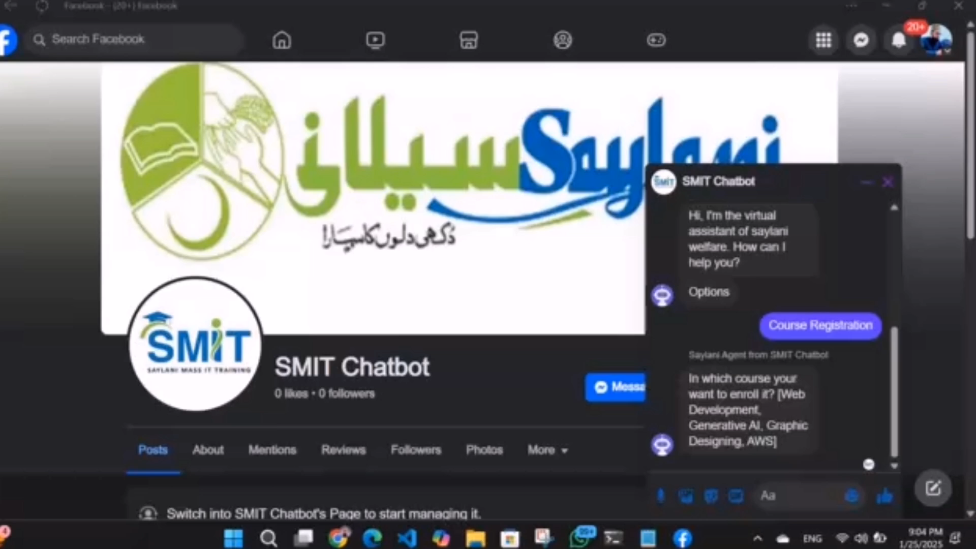
Facebook and WhatsApp Integration

Slide 8
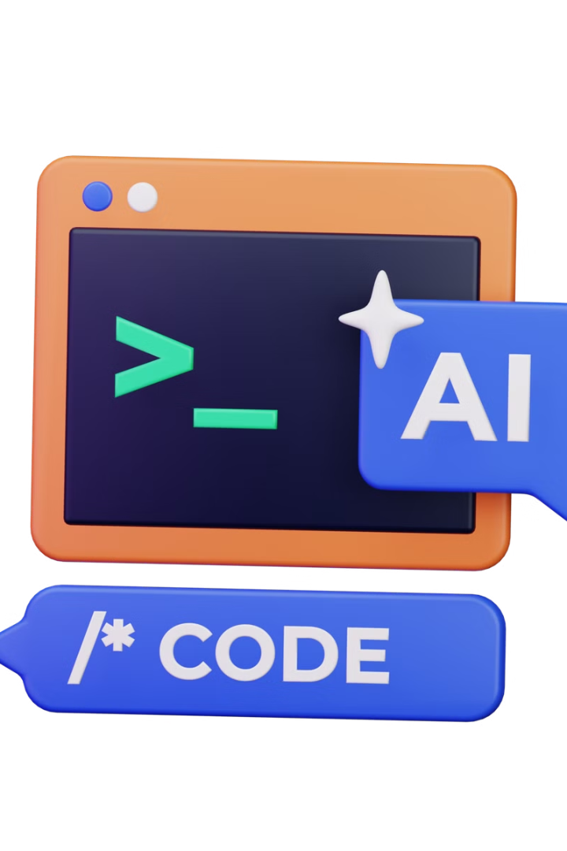
Deployment and Access
1
2
Deployment
Code Hosting
Deploy the chatbot on a cloud platform like Vercel, Netlify, Railway, or Render for accessibility and scalability.
Upload the chatbot code to GitHub for version control, collaboration, and open-source contributions.
3
Replit Integration
Share the chatbot code on Replit, a popular online coding environment, for easy access and experimentation.

Slide 9
THANK YOU
for watching this presentation

